Slide 1

Cognitive Self-Healing IT Infrastructure
DE8-2015-0155
Praveen Kumar Madhava Rao
Ashwini Alaguvel
Anuradha Rao

Slide 2
Prior Art
Prior Art | Our Idea Is Different
IBM Systems Director – Automates data center operations by implementing cloud-ready virtual infrastructures | Automates data center issues by implementing machine learning, cognition and natural language processing.
Automatic outage alert system (US 8331221 B2) - This patent requires the admin to manually check the status on the outage alert system. | Our idea ensures system admin receives automated alerts for issues in the infrastructure.
IOT method based on cognitive technology This patent takes inputs from layer 3 devices on the network. | “Our idea” takes inputs from ALL well known formats (or well known infra-events) like OS events, SAN events, SNMP traps, CMDB tickets & events from network intrusion prevention systems.

Slide 3
Prior Art
Prior Art | Our Idea Is Different
Method and Apparatus For Operations Big Data Analysis and Real Time Reporting Accepts remote input from monitoring apps on public and private cloud. Does massive big data analysis to provide priority usage alerts to users in the cloud. | “Our idea” can be applied to non-cloud infrastructures too. “Our idea” identifies & resolves issues.
Automated operations and service monitoring system for distributed computer networks (US 20020194319 A1) This patent displays an idea that does network diagnostics using cognition. | In “our idea”, the events are diagnosed based on machine learning of resolution steps learnt provided by a system admin. The diagnosis/troubleshooting is adaptable to new fixes.

Slide 4
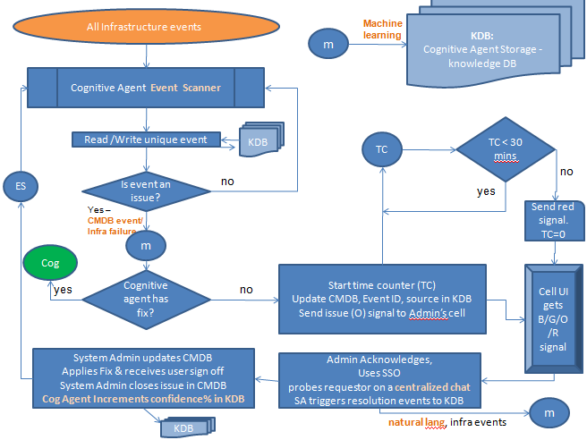
Dynamic issue resolution logic
Examples of
“All Infrastructure Events”
OS events sourced from
eventmgr, Unix EMU, etc
SNMP traps for all h/w events
Events from Network Intrusion
Prevention Systems
CMDB Events sourced from
ServiceNow Event Manager,
etc
IBM SVC event notifications
/HP XP array events
Resource allocation
logic -
Red signal will be sent
to backup admins.
Secure handshake bet
mobile networks will
enable issue transition
to a second admin.
Four Dots Mobile UI signal color codes - Blue (B) – connected to the network. Green (G) – no issues found, Orange (O) – Issue detected / Issue being addressed, Red ( R)– Issue not yet attended

Slide 5
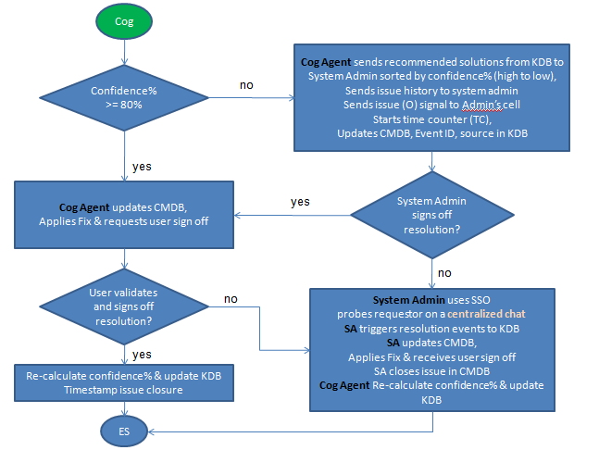
Confidence% calculation – when the issue has occurred <= 3 times, confidence% will be 50%
When the issue has > 3 times, the confidence% will be –
(number of successes of the resolution steps)/(number of times resolution was attempted)

Slide 6
KDB: Issue Log Table
CI name Source: CMDB | Event ID Source: KDB Table 2 | Issue Event Source: CMDB | SA’s user name Source: SSO Event | Fix recorded from SA’s steps Source: Resolution Events Natural language probing | Confidence% Source: calculation by Cognitive Agent
BLD-MC-01 | E001 | Unable to login | Ashlyn | Receive ID Validate user Add to accurate access group Request user to validate | 50%
NAS-01 | E123 | Unable to see files | Becki | Step1 Step 2 Step N | 90%
MACESS-05 | E908 | DB does not failover | Ryan | Not resolved | 0%
Event ID | Event Description
E009 | Boot issue
E001 | Unable to login
Read /Write unique event
KDB: Event Log Table

Slide 7
Existing Problems now resolved with “this idea”
Lack of dynamic issue resolution for infrastructure(analytic).
Lack of proactive (cognitive) & portable (mobile) issue management.
Lack of dynamic resource allocation if resolution is not within the scope of existing analytics.
Novelty / Claims
Incident management with machine learning.
Probing and troubleshooting with natural language.
Dynamic issue resolution.
High Availability of system admin through secure handshake.
The cognitive logic is adaptable to new, improved and changing solutions.
The cognitive logic is configurable.

